Slide 1

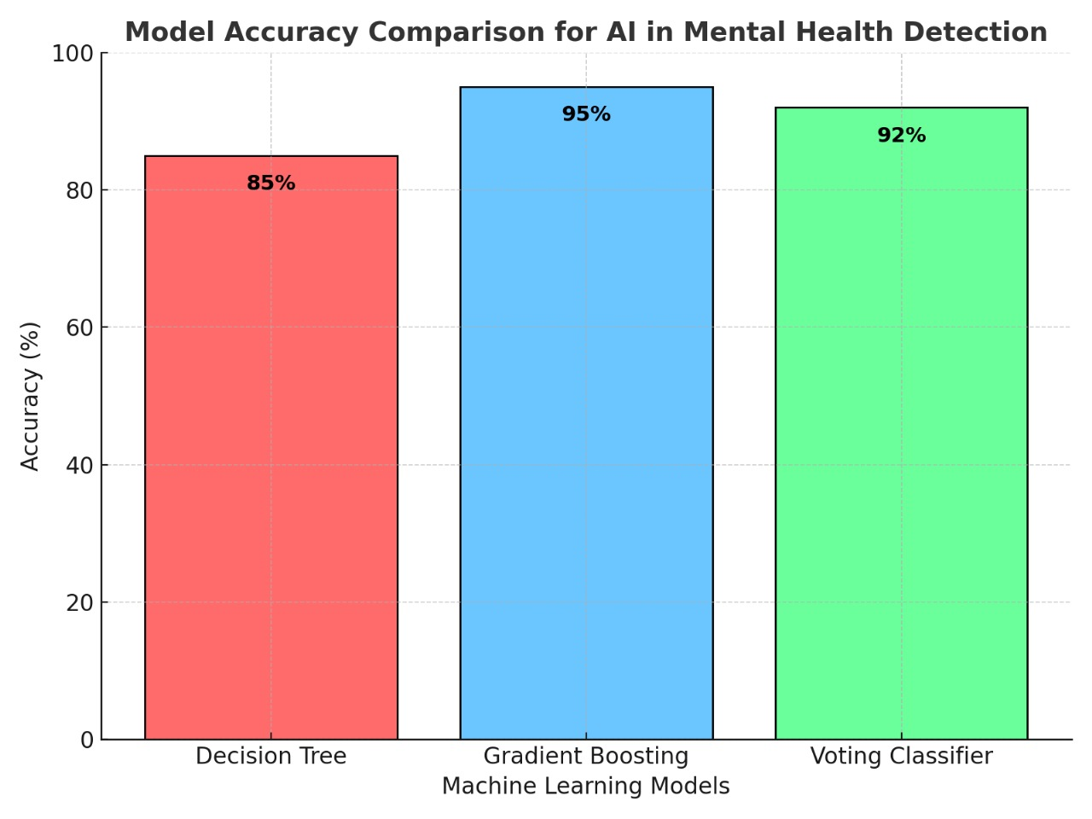
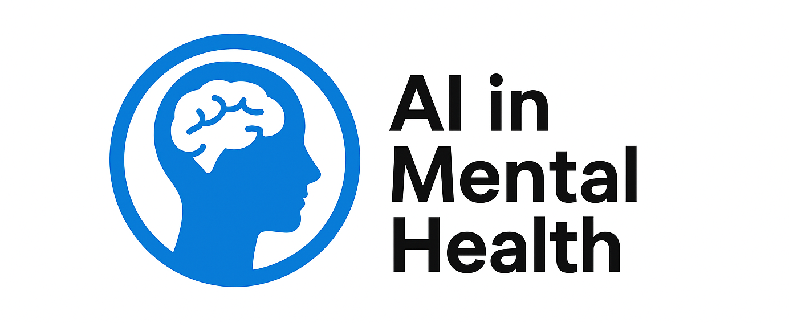
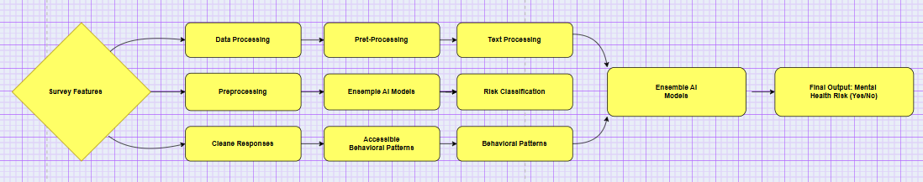
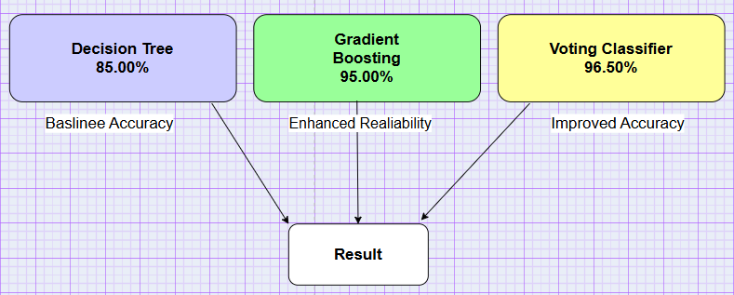


AI in Mental Health : Detecting Early Signs of Instability
Team: B. Sai Charan 2203A51400
K. Deepak 2303A51LB6 M. Anil 2303A51LA1
M. Pavan Kumar 2303A51LC0 B. Nithin 2303A51LA6
INTRODUCTION
RESULTS
Anxiety, stress and depression are increasing throughout most of the world. It is hard for early detection because of the subjective pericopes and limited specialist contact. We utilized Artificial Intelligence (AI) and Machine Learning to predict behavior which could possibly indicate mental infibulation by collecting information using a survey with the demonstration kept confidential.
The bagging classifier Voting Classifier did better in predicting early symptoms on mental instability with an accuracy of over 90%. The concatenated model was superior to single classifiers such as Decision Tree and Gradient Boosting in precision, recall, and F1-score. Our experiments showed the improvements by being more reliable, better generalization on unseen data and decreasing the number of false positives.
The feature importance analysis showed that work stress, family history, and treatment availability contributed the most to the predictions. The ensemble model provided a trade-off between all the evaluation metrics which, in turn, supported its efficiency for mental health risk prediction. In conclusion, the system was able to provide reliable and reproducible results for applications in real life.
METHODS
CONCLUSION
DISCUSSION
The initiative is a testament to the capabilities of AI in dealing with mental health issues. The collective model increased intelligibility and dependability. Future plans involve using LSTM text models and IoT tools to monitor in real time. The outcomes of the proposed system illustrate that high-level insights can be revealed from data-driven analysis for discovering latent demeanor variables associated with FEP. It is a link between psychological study and computational intelligence offering advantages of more objective estimates. The project also advocates for ethical AI usage, to protect privacy of data and fairness of prediction results. Emotional also lays the groundwork for building smart, real-time support systems that engender mental wellness at scale. The work also advocates the application of explainable AI methods such that predictions can be more transparent and can be trusted. Increasing its diversity with different population group can improve the generalization of the model and bring it bias down. Ultimately, this framework could grow into a worldwide digital mental health platform combining clinical knowledge with AI driven-predictions.
Dataset: The Mental Health Dataset (Kaggle), including demographic and behavioral data.
Data Preprocessing: Dealing with missing data, encoding categorical features, Standard Scaling.
Train Models: Decision Tree, Gradient Boosting, Logistic Regression, Light GBM, XG Boost.
Ensemble Learning: Voting Classifier to enhance the prediction.
Results: Four hundred seventy-four sentences were selected as the gold-standard dataset (Accuracy, Precision, Recall and F1-score).
The system effectively detects early signs of mental instability using AI-based ensemble models with high accuracy and strong privacy protection. It offers a scalable and non-invasive solution suitable for healthcare, workplaces, and educational institutions. By combining multiple machine learning techniques, it enhances reliability and reduces false predictions. Future advancements, such as deep learning integration and wearable sensor data, can further improve real-time monitoring, personalized feedback, and timely mental health intervention. The project also promotes early awareness and self-assessment, encouraging individuals to seek help before conditions worsen. Ultimately, it contributes to building a proactive and data-driven approach to mental wellness management.

